Slide 1
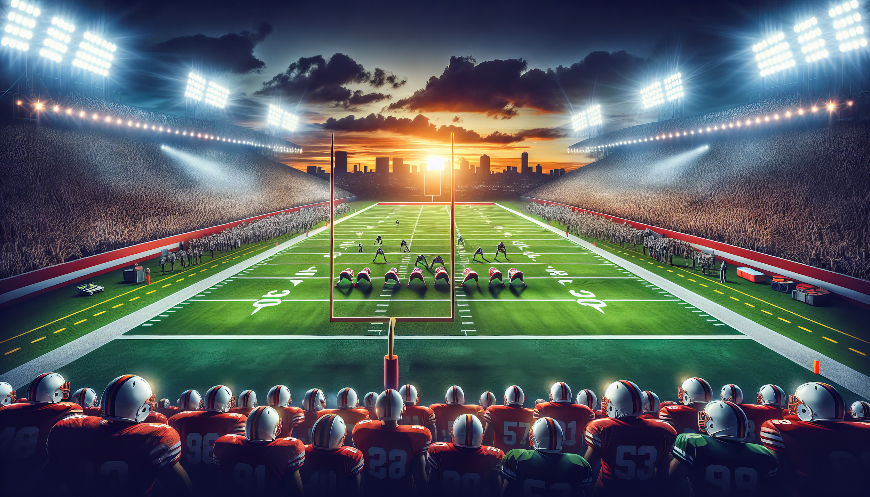
Predicting NFL Games
Jennifer Stipe, Atul Bachhav, Brandi Berry
July 9, 2024
Notes:
Jen

Slide 2
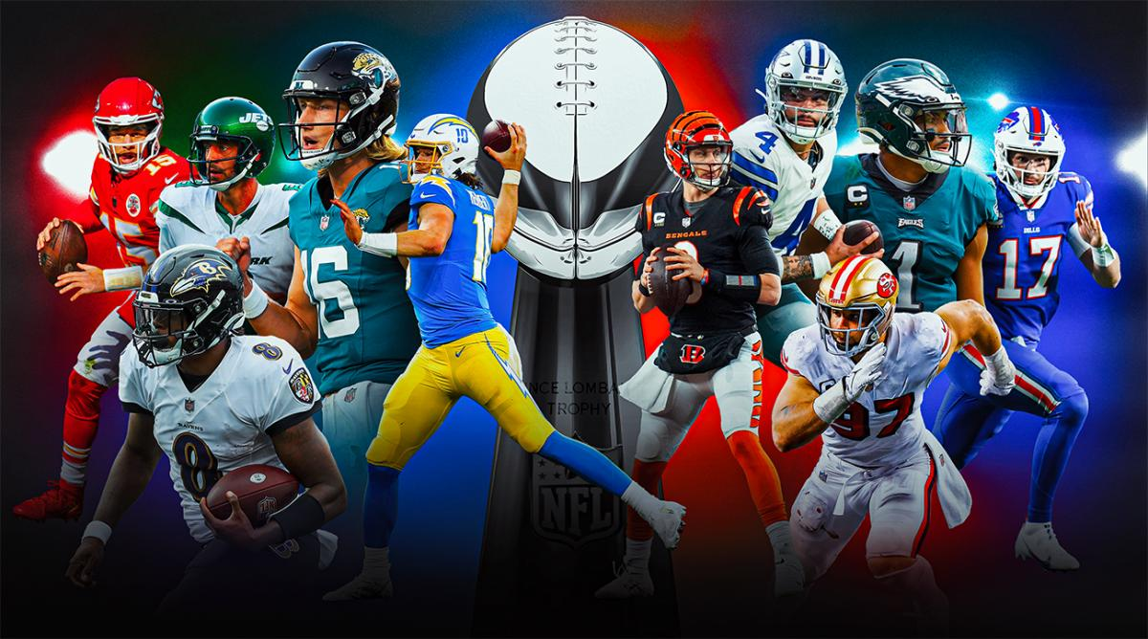
Project Goal
Analyze historical NFL data - home/away, weather conditions, game location, typical location weather, record against opponent, etc.
Classify top teams by winning percentage
Chart impact of total yards on score
Predict winner of future games
Notes:
Jen

Slide 3
Methodology
Data Clean up
Find appropriate data sources
Merge Data sources: NFL game score details, NFL Stadium details, Game weather details
Seperate home/away columns so that the data can be stacked vertically for easier reporting and modeling
Clean up team names - Oakland Raiders, LA Raiders, LV Raiders = Raiders
Clean missing surface data: If indoor stadium replace nulls with turf, if outdoor replace nulls with grass
Drop remaining rows with Null data leaving 9,260 rows to work with
Classification & Modeling
Determine the team that posted the highest score, the highest % of wins, and highest % of losses
Determine if there is a relationship between yards of offense and score
Use models to predict the winner of a given game
Notes:
Atul

Slide 4
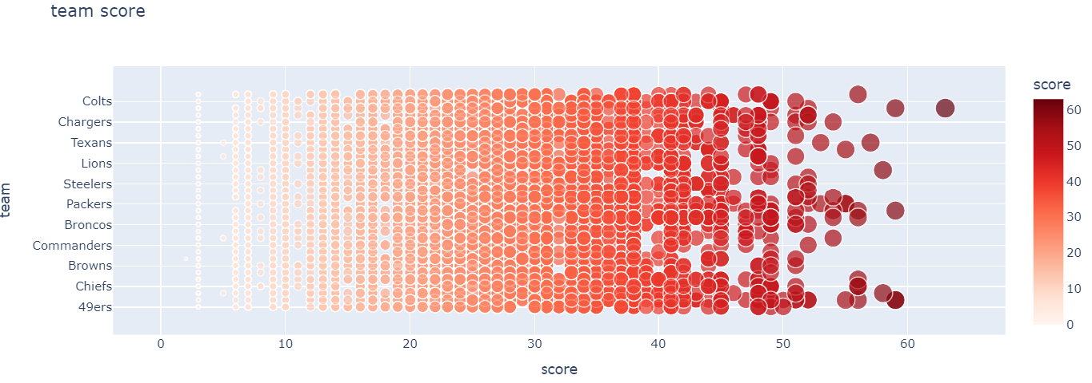
Team/Score Classification
The highest score recorded by a team in our cleaned dataset was 63 points by the Raiders during a game in Dec 2023
In actuality, the highest score by a single team from 2002-2023 was 70 by the Miami Dolphins 3 months previously in September of 2023. However, some data points for that game were missing so it was removed. Underscoring the need to understand the data, and the impact of cleaning has on it.
Notes:
Atul

Slide 5
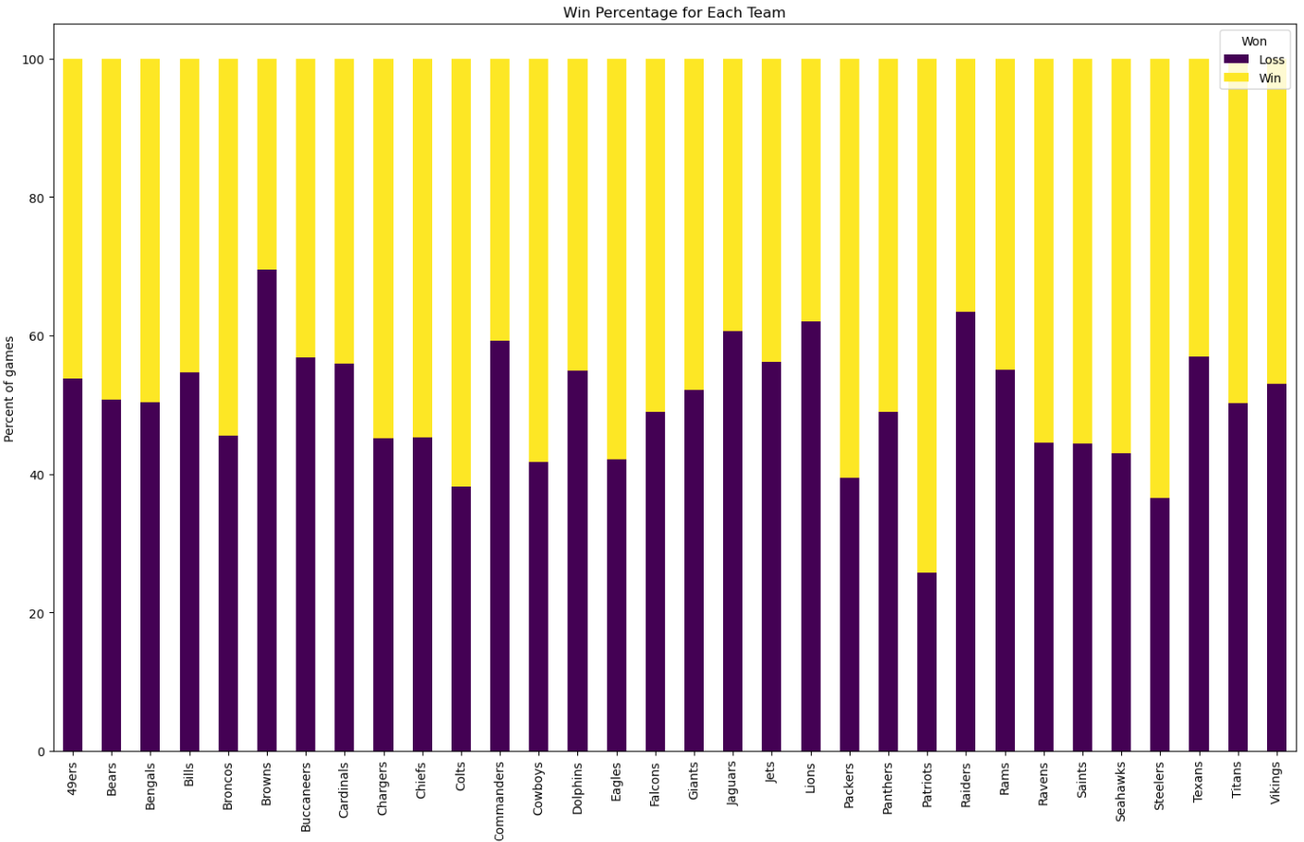
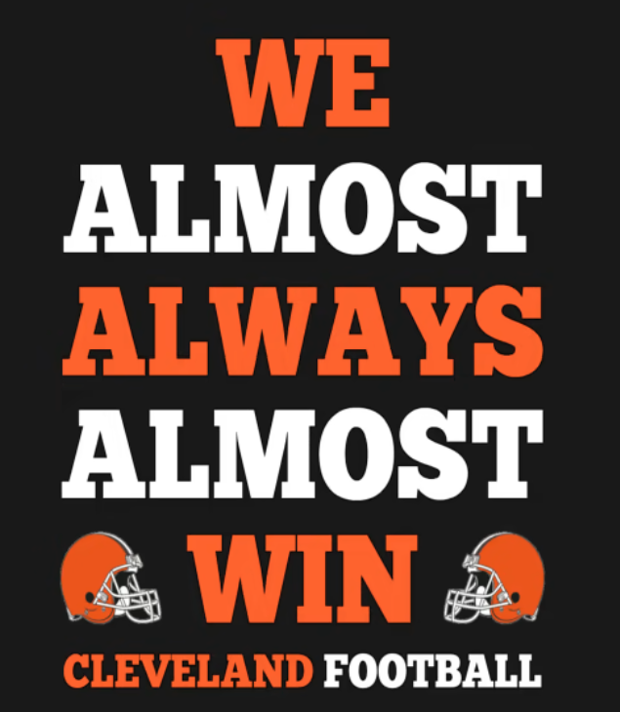
Wins/Loss by Team
The chart shows the Patriots have the highest winning percentage, while the Browns have the least, by quite a margin
Notes:
Brandi

Slide 6
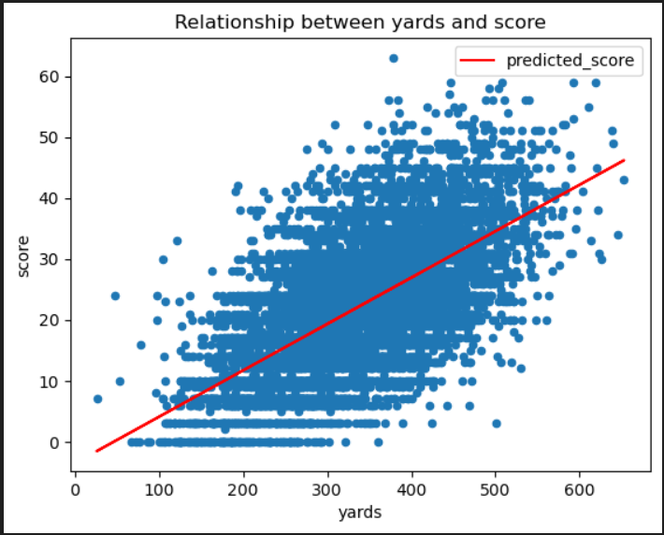
Passing yards impact on Score
A positive linear relationship exists between yards of offense and score
This information could be helpful in estimating scores of each team in a game based on their average yards for last several games
However, the r^2 value is only .398, meaning the two metrics have a moderate, but not strong relationship
Notes:
Brandi

Slide 7
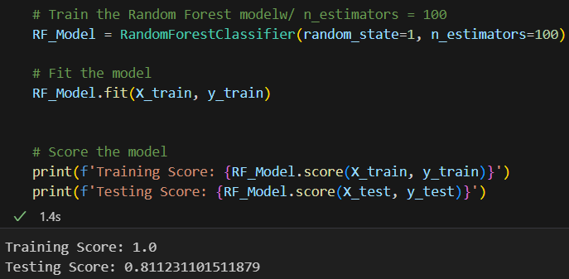
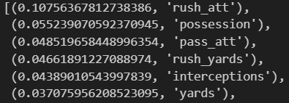
Modeling a Winner
Given the extensive number of attributes in our data, only the more complex models were attempted
Random Forest had the best model result, with test score of 81.1%
The variable contributing the most to the outcome were Rushing attempts, time of possession, and passing attempts
Given the extensive game details in the data set, there is definitely an X-factor in determining a win
Notes:
Jen

Slide 8
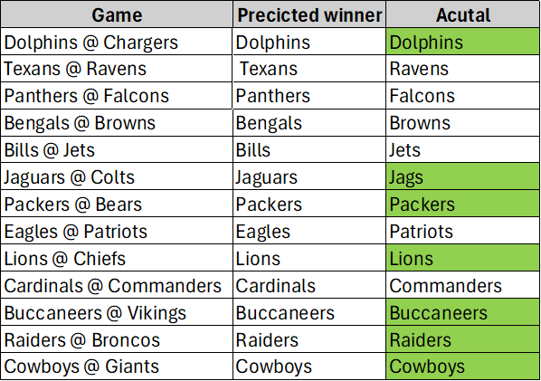
Predicting a Future Winner: NFL Week 1 2023
We trimmed our modeled data to remove 2023 data so we could use that see how well the model could prediction without the game data
Results of prediction vs what happened were 57.1%, which is not as good as current Vegas standards.
Notes:
Jen

Slide 9
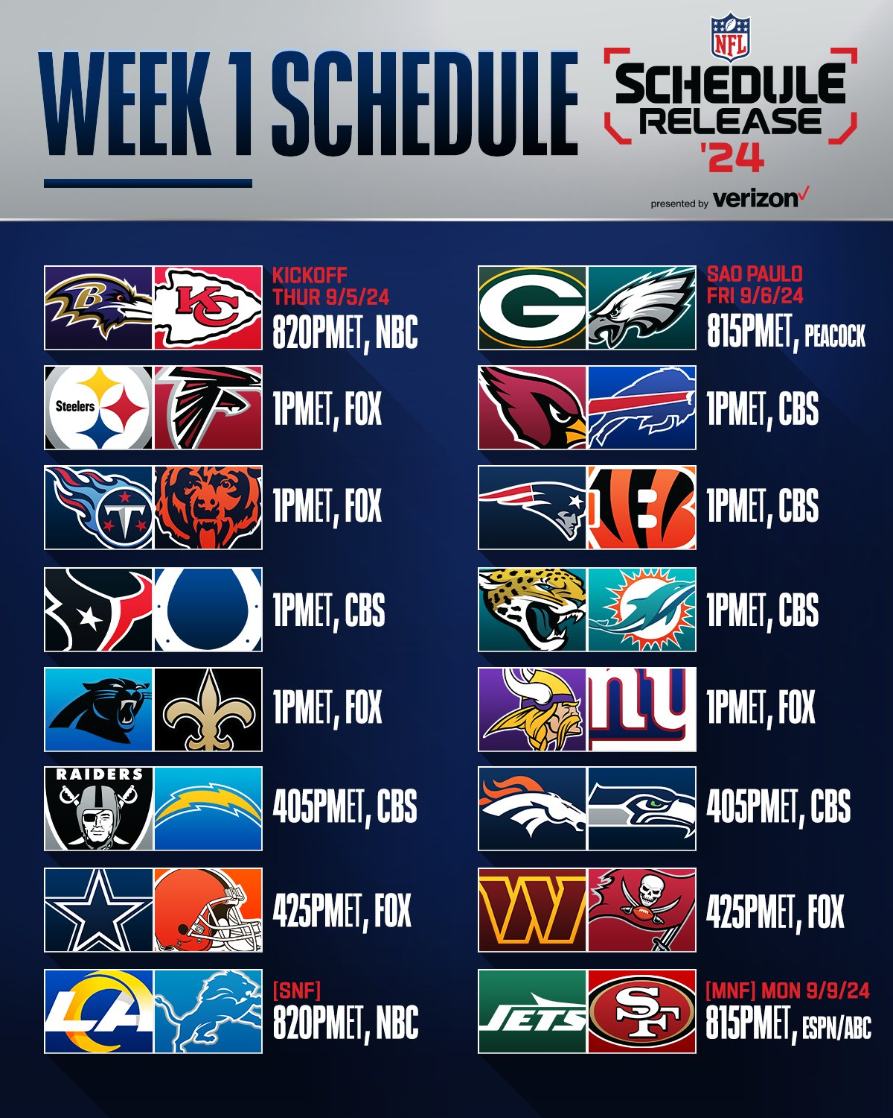
Next Steps
Determine the ‘X’ factor in determining a win to increase the accuracy rate
Quarterback
Head Coach
Defensive rank
# of Take-Aways
# of starters on IR
Create a user interface to allow for entry of future games and provide an predictive outcome
Notes:
Jen

